Slide 1
Digital Portfolio
STUDENT NAME: Iswariyalakshmi M
REGISTER NO AND NMID: 2428M0016 and 04A79D056CB2D1DBC6444FA273861302
DEPARTMENT: BSc.Data Science
COLLEGE: COLLEGE/ UNIVERSITY : Kumaraguru College of Liberal Arts and Science / Bharathiyar University

Slide 2
PROJECT TITLE
My Interactive Digital Portfolio using front end web development

Slide 3


AGENDA
Problem Statement
Project Overview
End Users
Tools and Technologies
Portfolio design and Layout
Features and Functionality
Results and Screenshots
Conclusion
Github Link
3/21/2024 Annual Review

Slide 4

PROBLEM STATEMENT
In today’s digital era, students and professionals often struggle to present their skills, achievements, and projects in a way that feels both engaging and personalized. Traditional resumes and static documents fail to capture creativity or provide an interactive experience to showcase one’s work. This creates a gap between what an individual can do and how effectively they can communicate it to peers, recruiters, or institutions.
To solve this, “My Interactive Digital Portfolio” is designed as a personalized, web-based platform using HTML and CSS, where information is presented in a visually appealing and structured manner. Unlike a simple text-based CV, this digital portfolio allows for a more interactive and human-centered representation of identity, skills, and accomplishments—making it easier for others to truly understand the creator’s capabilities.

Slide 5

PROJECT OVERVIEW
The project “My Interactive Digital Portfolio” is a front-end web development initiative designed to showcase personal and professional information in an engaging, structured, and visually appealing way. Built using HTML and CSS, the portfolio serves as a modern alternative to traditional resumes by providing an interactive platform where skills, achievements, educational background, and projects can be highlighted.
The main objective of this project is to create a user-friendly digital identity that not only reflects technical knowledge in web development but also demonstrates creativity in design and presentation. The portfolio is designed to be responsive, ensuring accessibility across devices, and emphasizes simplicity, readability, and interactivity.
Through this project, the aim is to bridge the gap between personal branding and technical skills, allowing viewers—such as recruiters, peers, and educators—to get a clear, engaging, and professional impression of the portfolio owner.

Slide 6

WHO ARE THE END USERS?
The main end users of this portfolio are recruiters and hiring managers, who can quickly get a professional impression of me; teachers and evaluators, who can assess my technical work and presentation skills; and peers or collaborators, who may want to connect, learn, or work with me. In short, anyone who wishes to know more about my skills and personality in an interactive way can benefit from this portfolio.

Slide 7

TOOLS AND TECHNIQUES
The tools and technologies used in this project includes :
HTML
CSS
JAVASCRIPTS
VISUAL STUDIO CODE

Slide 8
POTFOLIO DESIGN AND LAYOUT
The design of “My Interactive Digital Portfolio” is kept clean, simple, and easy to navigate so that anyone visiting can quickly get to know me. The portfolio starts with a welcoming homepage that shows my name, photo, and a short introduction. From there, it flows into sections like About Me, where I share a little about my background and goals, followed by Education and Skills, which highlights what I’ve learned and the tools I can use. My projects are displayed in a neat, gallery-like format with short descriptions, while achievements and certifications are listed clearly to showcase my progress. Finally, the Contact section makes it easy for people to reach out to me through email or social links. The entire layout is built using HTML and styled with CSS, focusing on a professional look, smooth readability, and responsiveness so it works well on any device.
8

Slide 9
FEATURES AND FUNCTIONALITY
The “My Interactive Digital Portfolio” is designed to feel simple yet engaging, making it easy for anyone to explore. It allows smooth navigation between sections like About Me, Education, Skills, Projects, and Contact, so visitors can quickly find what they’re looking for. The portfolio is responsive, which means it adjusts nicely to any screen whether on a computer, tablet, or phone. To make it more lively, I’ve added small interactive touches like hover effects, clickable links to my LinkedIn or GitHub, and neatly organized project showcases. There’s also a dedicated contact section so people can easily reach out to me. Overall, the portfolio is built to be more than just a static webpage it works as a personal space that reflects both my technical skills and creativity.

Slide 10
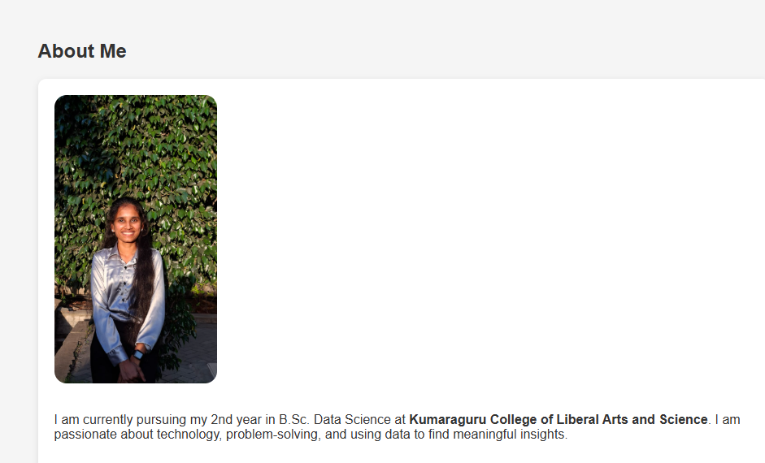
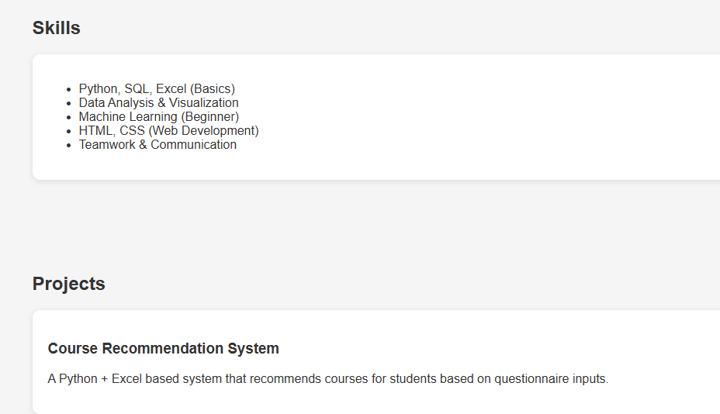
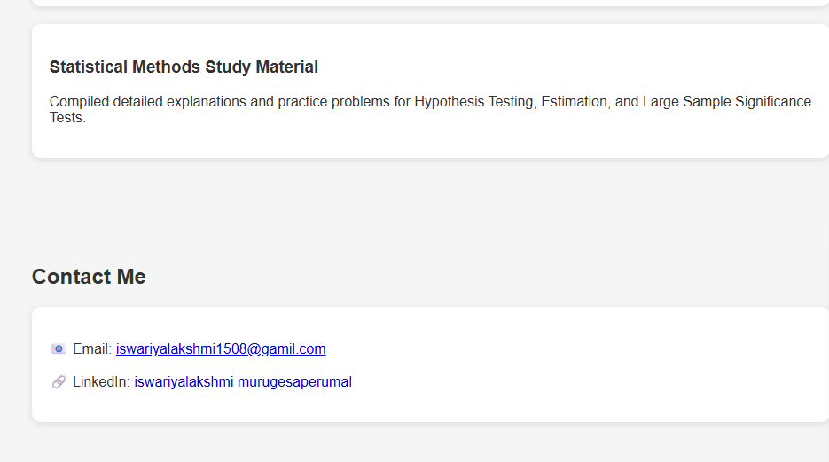
RESULTS AND SCREENSHOTS
3/21/2024 Annual Review
10

Slide 11
CONCLUSION
In conclusion, “My Interactive Digital Portfolio” is more than just a technical project—it is a reflection of both my skills and my personality. By using simple front-end tools like HTML and CSS, I was able to design a responsive, user-friendly, and creative space that presents my education, skills, projects, and achievements in an engaging way. Unlike a traditional resume, this portfolio feels more alive and interactive, making it easier for others to truly understand who I am and what I can do. Through this project, I not only strengthened my web development knowledge but also learned the importance of design, presentation, and personal branding in today’s digital world.
11

